Slide 1


Hygiene in the non-clinical environment
Dirk Bockmühl

Slide 2
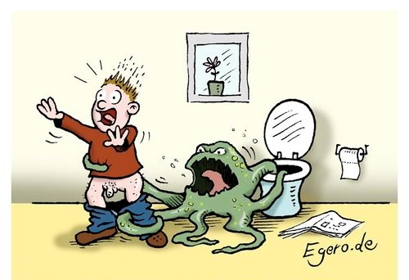
Hygiene at home?
Gerd had rather spent more money in toilet cleaning agents…

Slide 3
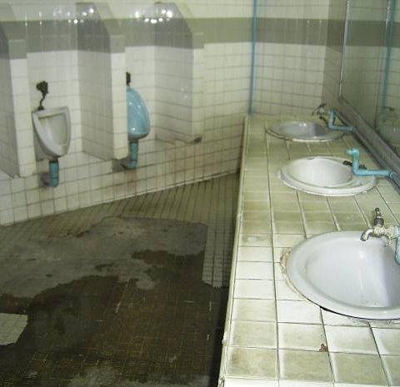
Home hygiene: the consumer’s view
Hygiene threats are mostly found outside my home
According to a GfK survey for the „Apotheken-Umschau“ 2006

Slide 4
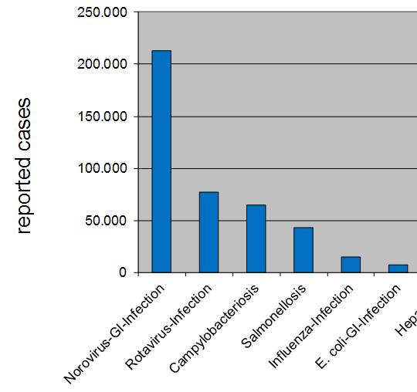

Notifiable infections in Germany (2008)
Source: RKI

Slide 5

Household-associated infections
Krause et al.: Emerg Inf Dis 13(10) (2007)

Slide 6

The key message
The domestic environment is one of the most important sources for infectious diseases
These infections are predominately food-borne

Slide 7
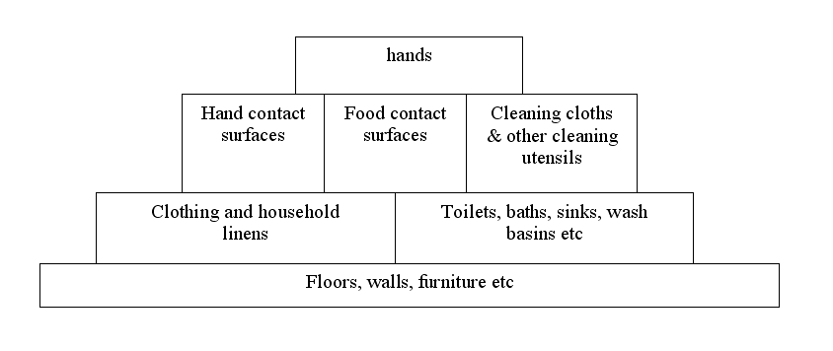
The risk of infection at home
Risk
Source: IFH
7

Slide 8
The risk of infection at home
Risk
Source: IFH

Slide 9


Decontamination of food contact surfaces

Slide 10
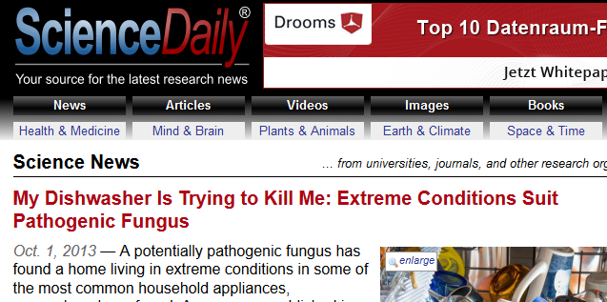
The dishwasher: a risk?

Slide 11
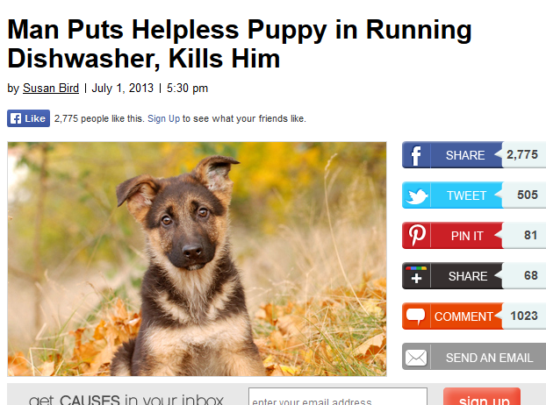

Slide 12
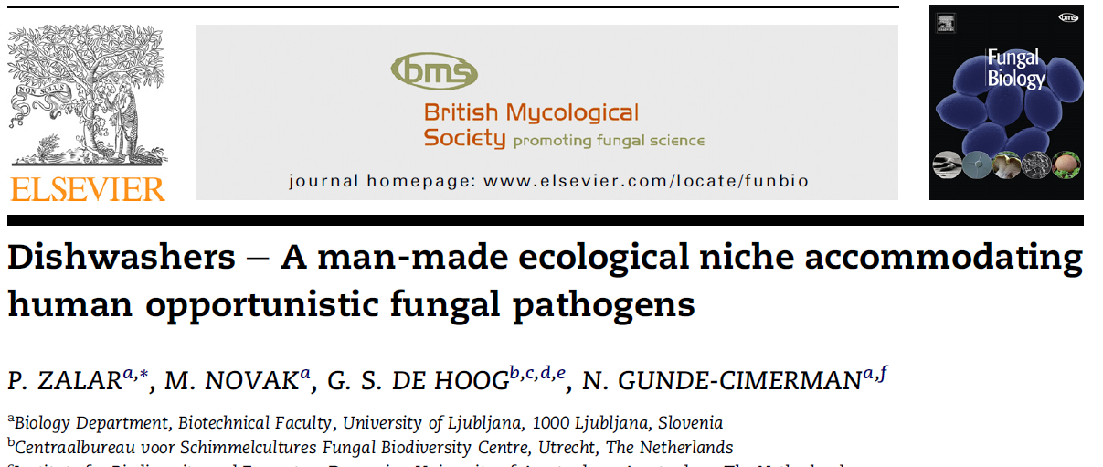
Dishwashers host black yeasts

Slide 13
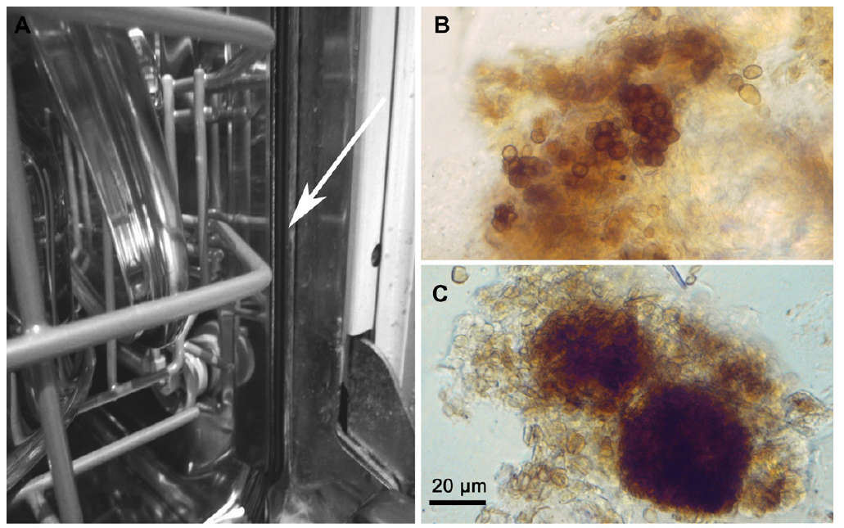
Dishwashers host black yeasts
Zalar et al. (2011)

Slide 14


But is there a risk of infection?
?

Slide 15

Estimation of infection risk
Pathogenic microbes?
Routes of infection?
Exposition?
Risk factors?

Slide 16


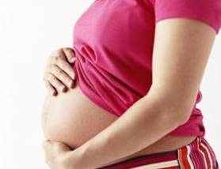

Groups of higher risk: YOPIs
Young
Old
Pregnant
Immunocompromised

Slide 17
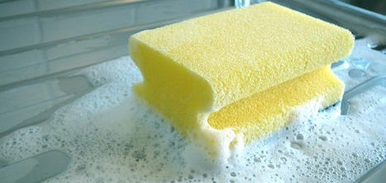
Antibacterial effect of hand dishwashing
Time needed to reduce 99,9% of Salmonella
Water
Soaking time [min]
Water + Detergent
Temperature [°C]
Mattick et al.: Int J Food Microbiol 85 (2003) 213– 226

Slide 18
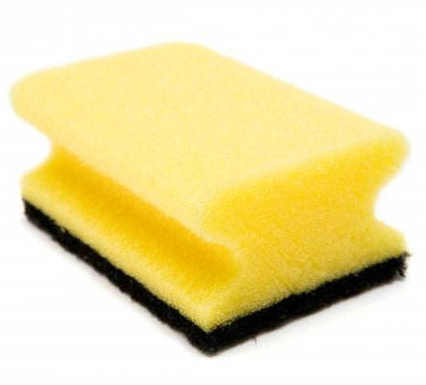
The „killer“ sponge
10² – 10⁷
microbial cells
per gramm
SEM-photograph: A. Hinnemann, Rhine-Waal University of Applied Sciences
Enriquez et al. Dairy Food Environ. Sanitation. 17:20-24.

Slide 19
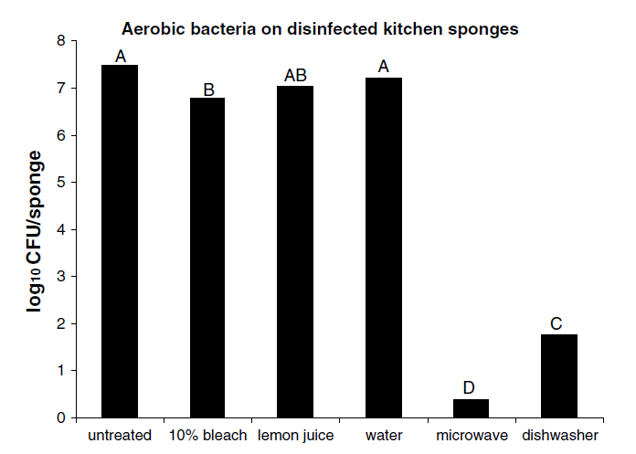
How to sanitize a kitchen sponge
Sharma et al. Food Control 20 (2009) 310–313

Slide 20
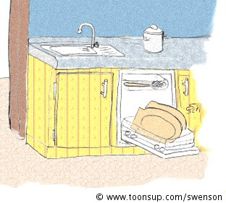
The dishwasher kills…

Slide 21
The dishwasher kills…
…bacteria!
Thus it is an important means to ensure decontamination of food-contact surfaces

Slide 22
The risk of infection at home
Risk
Source: IFH

Slide 23
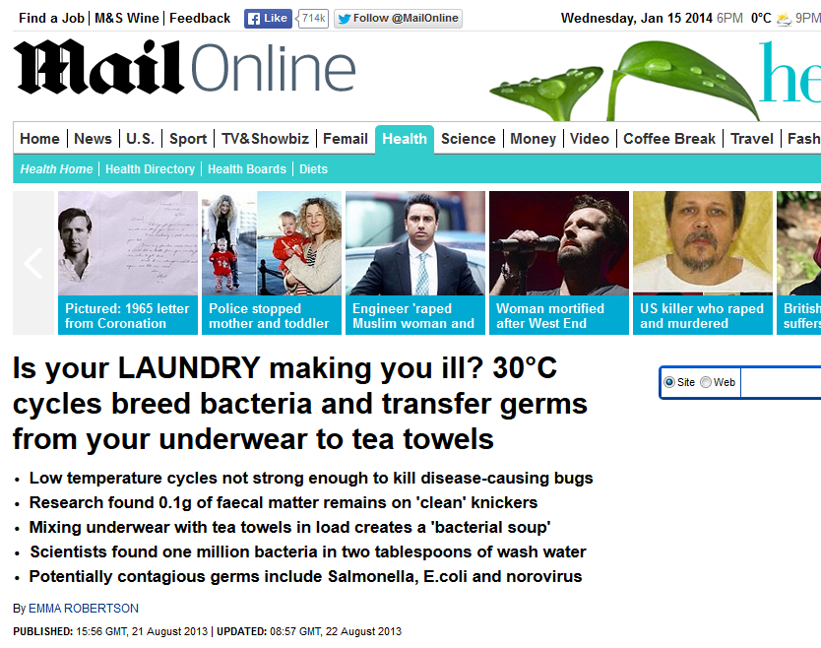
The washing machine as source of germs

Slide 24
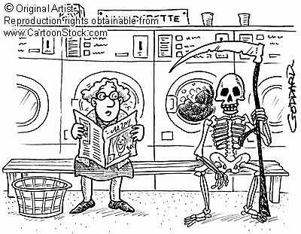
Will we all die now?

Slide 25
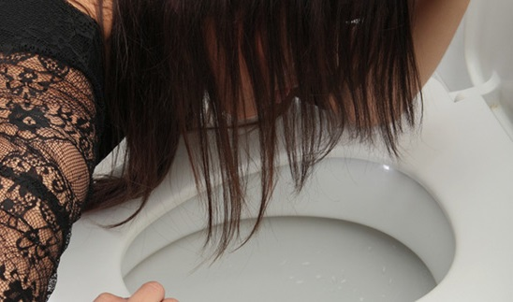
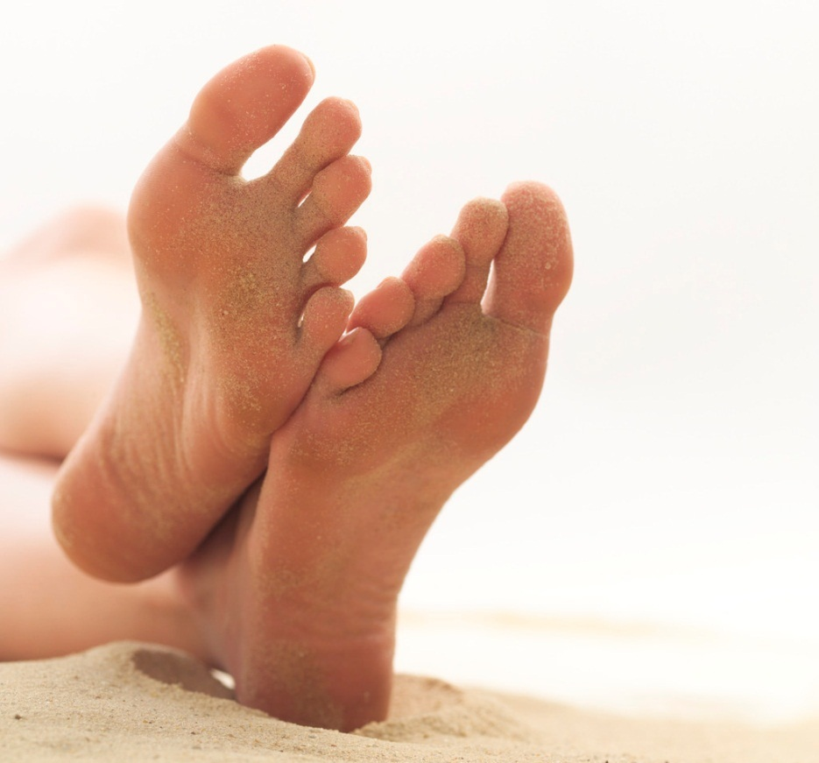
Infections and laundering
Fungal infections
(Athlete‘s foot, Candida)
Viral infections
(Noroviruses)

Slide 26
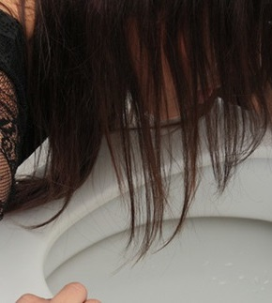
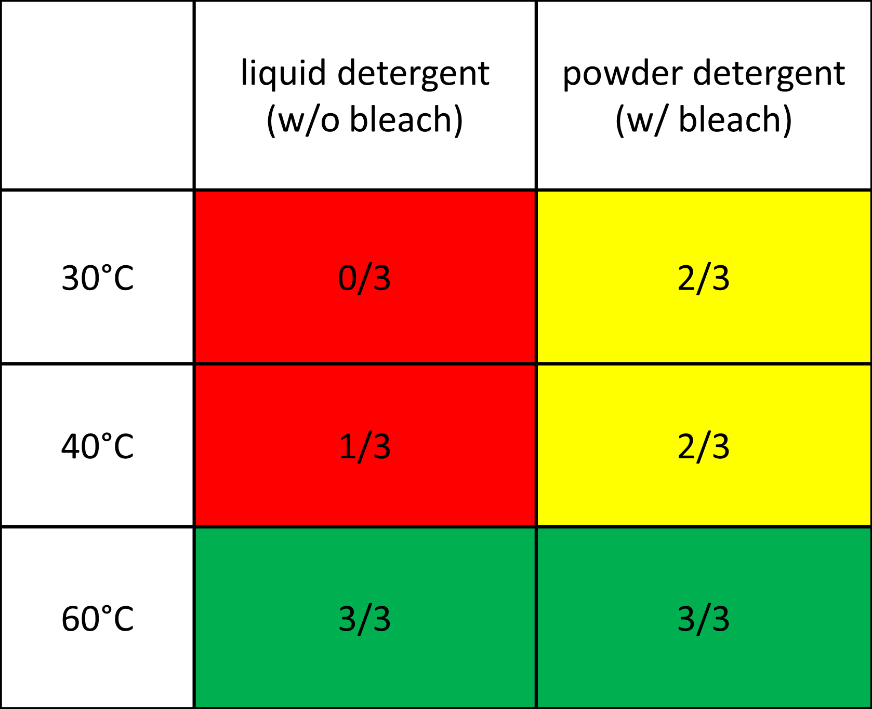
Inactivation of Norovirus via laundering
Detection of viral RNA on fecally contaminated textiles
Lemm et al. Tenside, Surfactants, Detergents (submitted)

Slide 27
Challenge: low temperatures
Medium washing temperature
T [°C]
%
Textiles washed at ≥60°C
Survey on german households
Source: IKW Sustainability Report 2010

Slide 28
Hygiene in the wash- and use-cycle
Wearing
Storage
Washing
Drying

Slide 29
Hygiene in the wash- and use-cycle
Input of microorganisms
Wearing
Storage
Washing
Reduction of microorganisms
Drying

Slide 30
Hygiene in the wash- and use-cycle
Input of microorganisms
skin flora
excretions
biofilms
cross
contami-nation
fungal
spores
dust
Wearing
Storage
Washing
Reduction of microorganisms
Drying
chemistry
mechanics
temp.
dehydration
dehydration
temperature

Slide 31
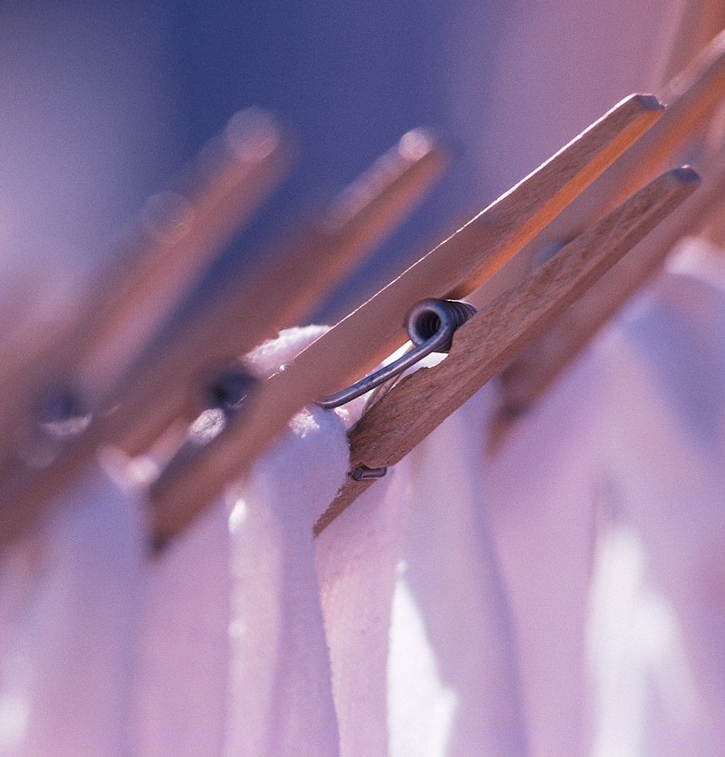
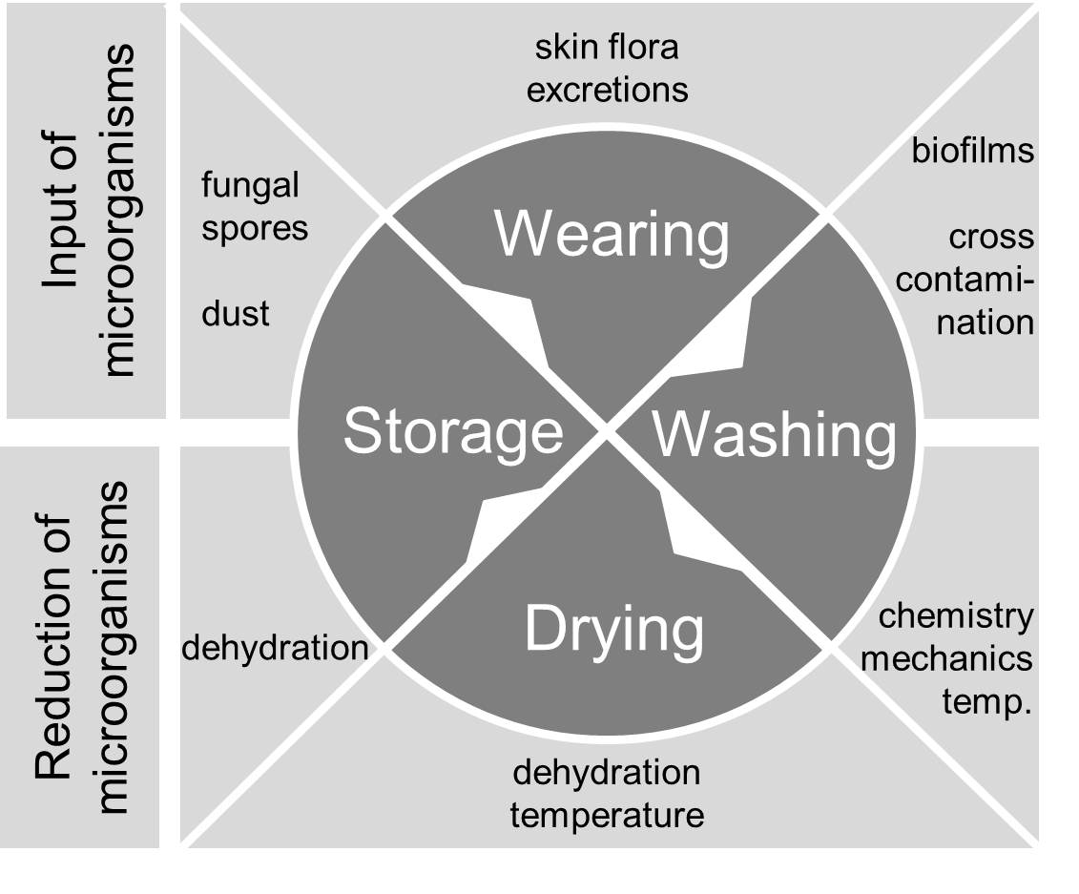
Challenges

Slide 32

Challenges
Wich microbes?
Quantity?

Slide 33
Challenges
Machine impact?

Slide 34
Challenges
Impact of drying and ironing?

Slide 35
What happens when you wash your towels?
cfu/cm²
After use
After laundering
After drying
Blümke et al., EDC conference 2011

Slide 36
What happens when you wash your towels?
cfu/cm²
After use
After laundering
After drying
Blümke et al., EDC conference 2011

Slide 37
What happens when you wash your towels?
cfu/cm²
After use
After laundering
After drying
Blümke et al., EDC conference 2011

Slide 38
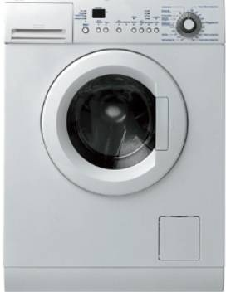
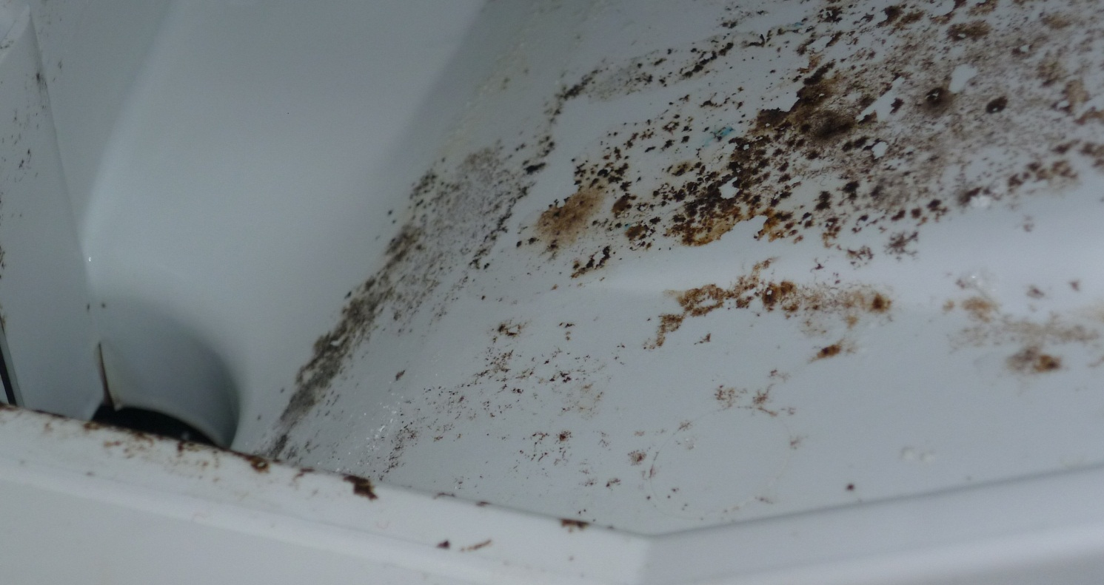
The washing machine as a reservoir for germs
Microbial colonisation of the rinsing chamber is independent of the chosen temperature
Contamination after the main wash cycle

Slide 39

Another real-life study…
Analysis of Laundry in Nursery Homes

Slide 40
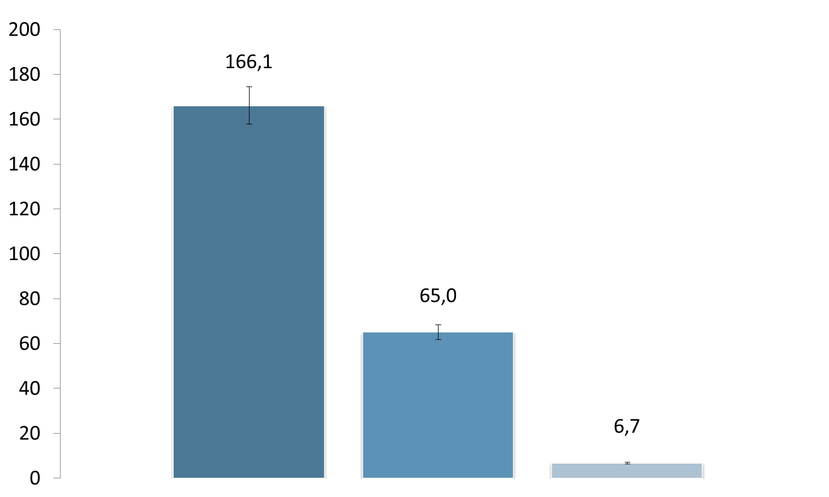

Analysis of Laundry in Nursery Homes
cfu / 100 cm²
Before laundering
After laundering
After drying
Survey on 16 nursery homes in the district of Kleve
Bertelmann et al., DGHM conference 2012

Slide 41
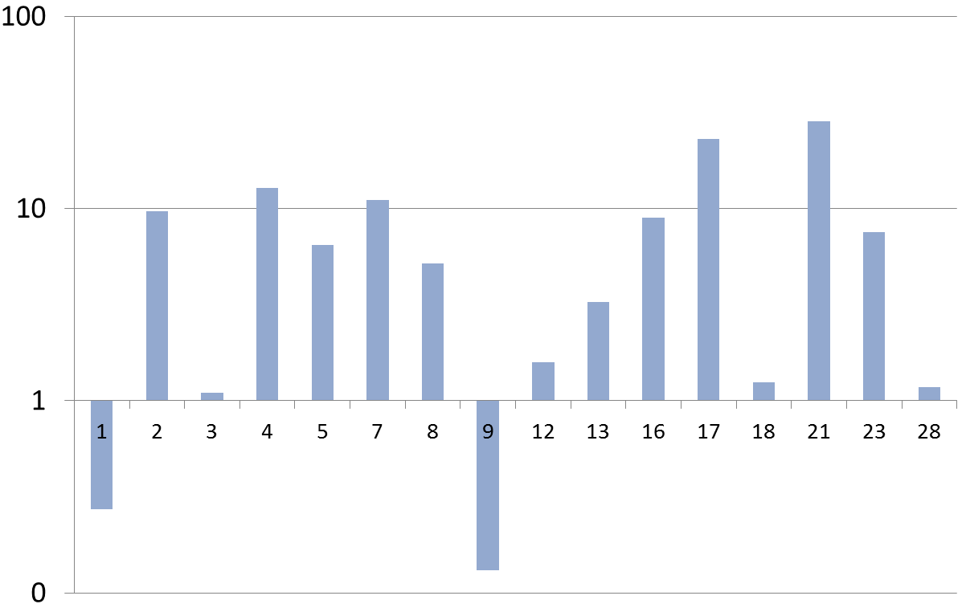
Individual reduction factors
Log reduction (before/after laundering)
Nursery home #
Bertelmann et al., DGHM conference 2012

Slide 42
Impact factors on laundry hygiene
Bertelmann et al., DGHM conference 2012

Slide 43
Impact factors on laundry hygiene
Bertelmann et al., DGHM conference 2012

Slide 44
Impact factors on laundry hygiene
Bertelmann et al., DGHM conference 2012

Slide 45
Impact factors on laundry hygiene
Bertelmann et al., DGHM conference 2012

Slide 46
Impact factors on laundry hygiene
Bertelmann et al., DGHM conference 2012

Slide 47
Analysis of Laundry in Nursery Homes
Very low counts after tumble drying
cfu / 100 cm²
Before laundering
After laundering
After drying
Bertelmann et al., DGHM conference 2012

Slide 48
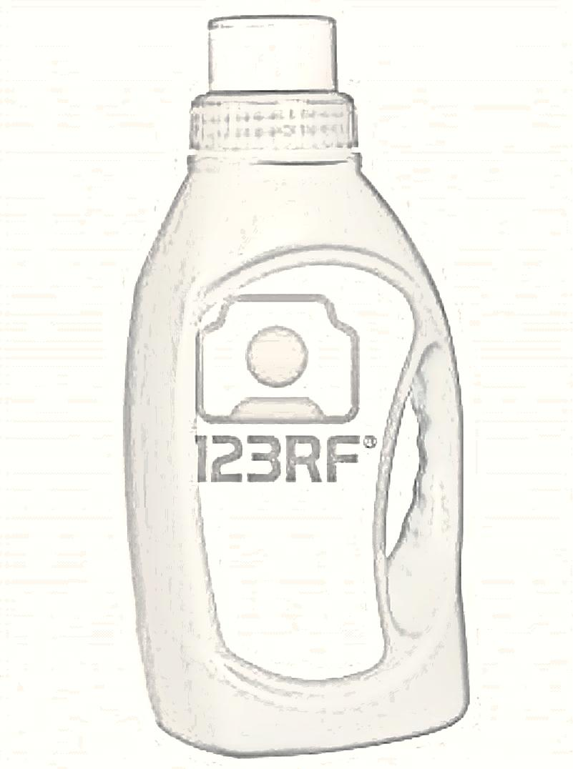
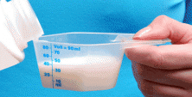
Do hygiene rinsers help?
Hygiene
+
Source: Forum Waschen

Slide 49
Do hygiene rinsers help?
Claim: Kill 99,9(99)% of germs
Substantiated via suspension tests
Source: Forum Waschen

Slide 50
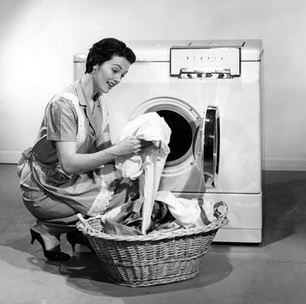
Efficacy in the washing machine?
Additional detergency effect
Textile effect
Different germs
etc.

Slide 51
Powder detergent with hygiene rinser
Lucassen et al., Tenside, Surfactants, Detergents (2013)

Slide 52
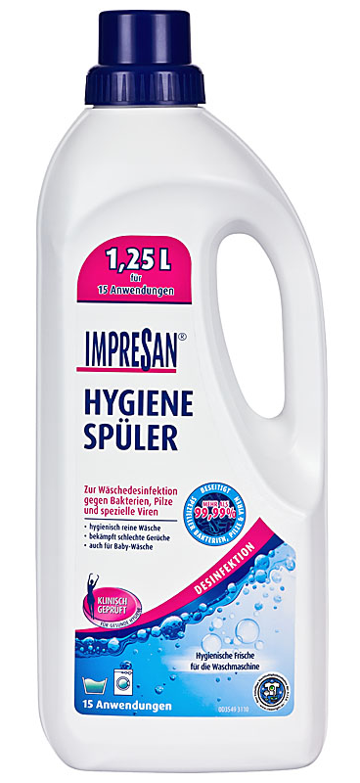
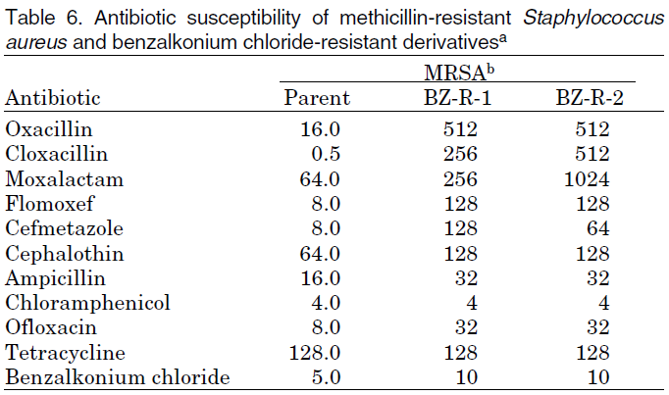
Cross resistance between antibiotics and biocides
Akimitsu et al.: Antimicrob Agents Chemother 1999;43:3042-3

Slide 53
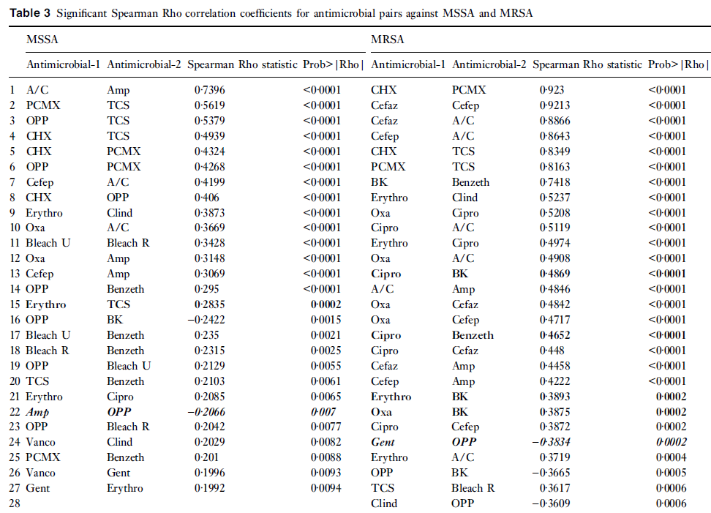
Cross-resistance
Lambert: Journal of Applied Microbiology 2004, 97, 699–711

Slide 54

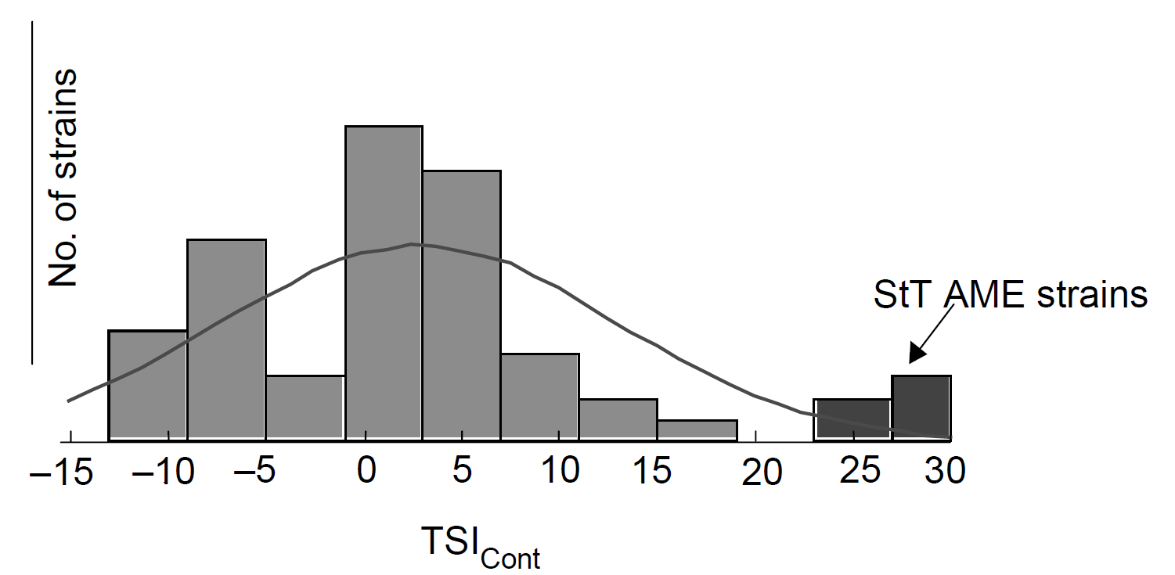
Resistance profile vs. origin
# Isolates
Anzahl
Klinische Isolate
Clinical Isolates
TSI: Total Susceptibility Index
Lambert et al.: Journal of Applied Microbiology 2001, 91, 972±984

Slide 55
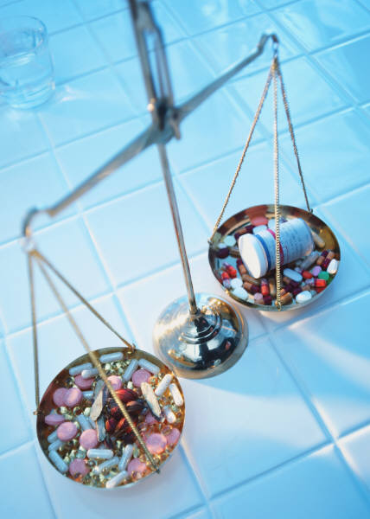
Does biocide use enhance antibiotic resistance?
Clinical isolates are more resistance in general
Antibiotic resistance is predominately found in clinical isolates
Clinical environment fosters resistance
Lambert et al.: Journal of Applied Microbiology 2001, 91: 972-984

Slide 56
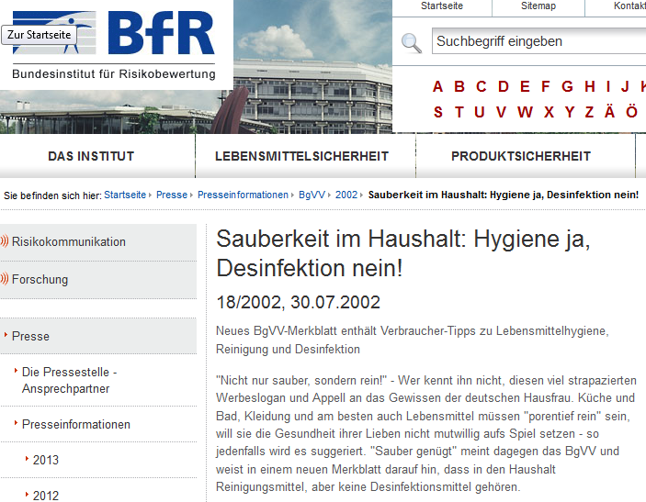
Biocides at home?

Slide 57
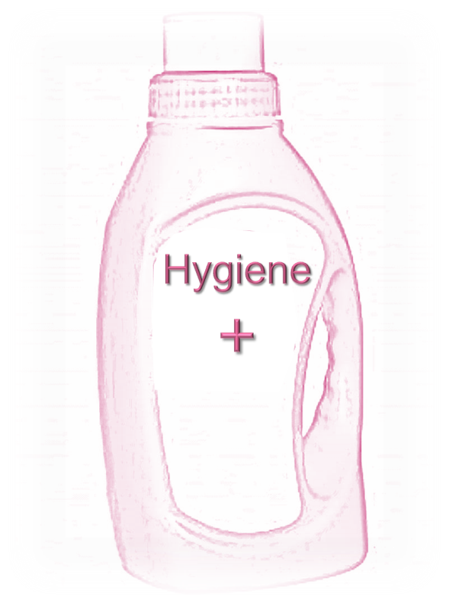
Biocides at home?
Hygiene rinsers:
only for special cases

Slide 58
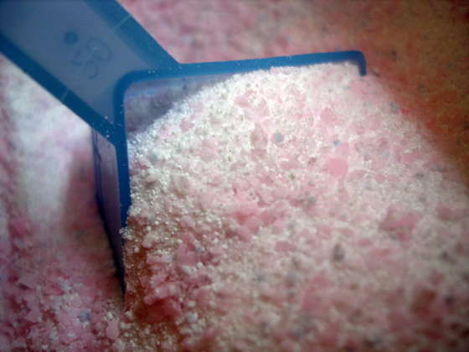
Biocides at home?
http://londoncleaning-services.co.uk
Hygiene rinsers:
only for special cases
Detergents with activated oxygen bleach ensure sufficient hygiene

Slide 59
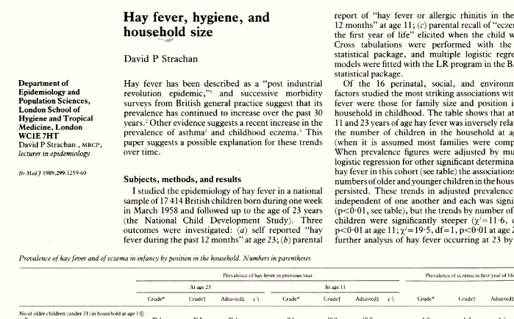
Are we too clean? The hygiene hypothesis
Strachan (1989):
20th century rise in allergic diseases is related to lower incidence of infection in early childhood

Slide 60

Hygiene hypothesis: the consumer‘s view
„We need some bacteria to train our immune system“
„Too clean is harmful“

Slide 61

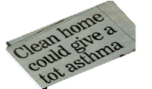


Hygiene hypothesis: the consumer‘s view

Slide 62
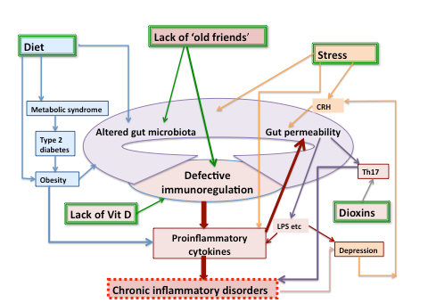

Hygiene hypothesis: the scientific view
Taken from: Smith et al.: The Hygiene Hypothesis and its implications for home hygiene, lifestyle and public health, IFH review 2012; based on: Rook G Clin Exper Immunol 2010; 160:70-79.

Slide 63
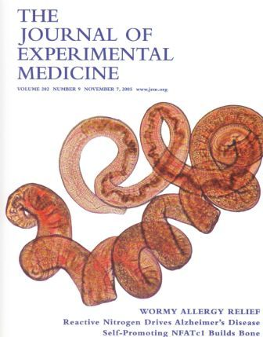
Old friends hypothesis (Graham Rook)
Microorganisms that were once abundant
(but aren‘t any more)
trained our immune system to be more tolerant:
Lactobacilli
Saprophytic Mycobacteria
Parasitic worms

Slide 64
Are we too clean?
Cleaning does most probably not increase the risk for allergy and asthma

Slide 65
Are we too clean?
Cleaning does most probably not increase the risk for allergy and asthma
The targeted use of cleaning and antimicrobial products may help to reduce the risk for household-associated infections

Slide 66
Targeted Hygiene
Risk
Source: IFH

Slide 67
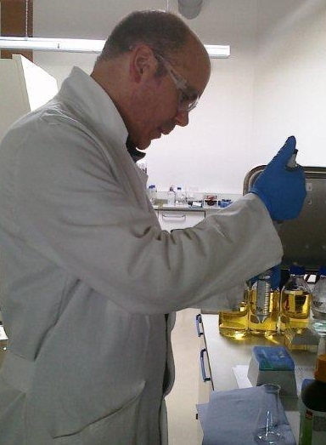
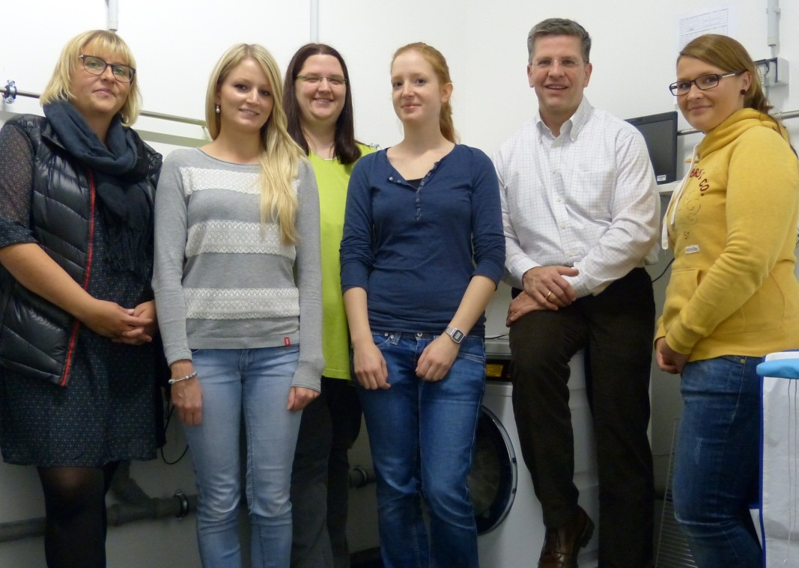

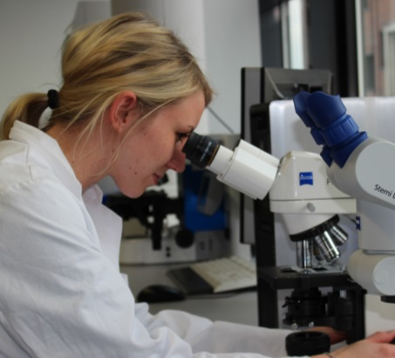
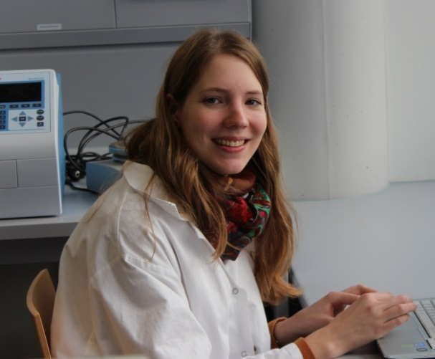
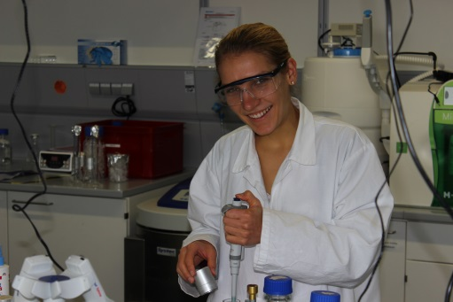
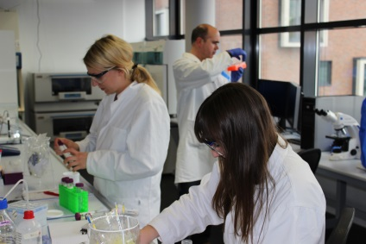
Thanks
Britta Brands, Angelina Eckert, Marlitt Honisch, Davina Lemm,
Ralf Lucassen, Nadine Merettig, Ramona Steiner

Slide 68
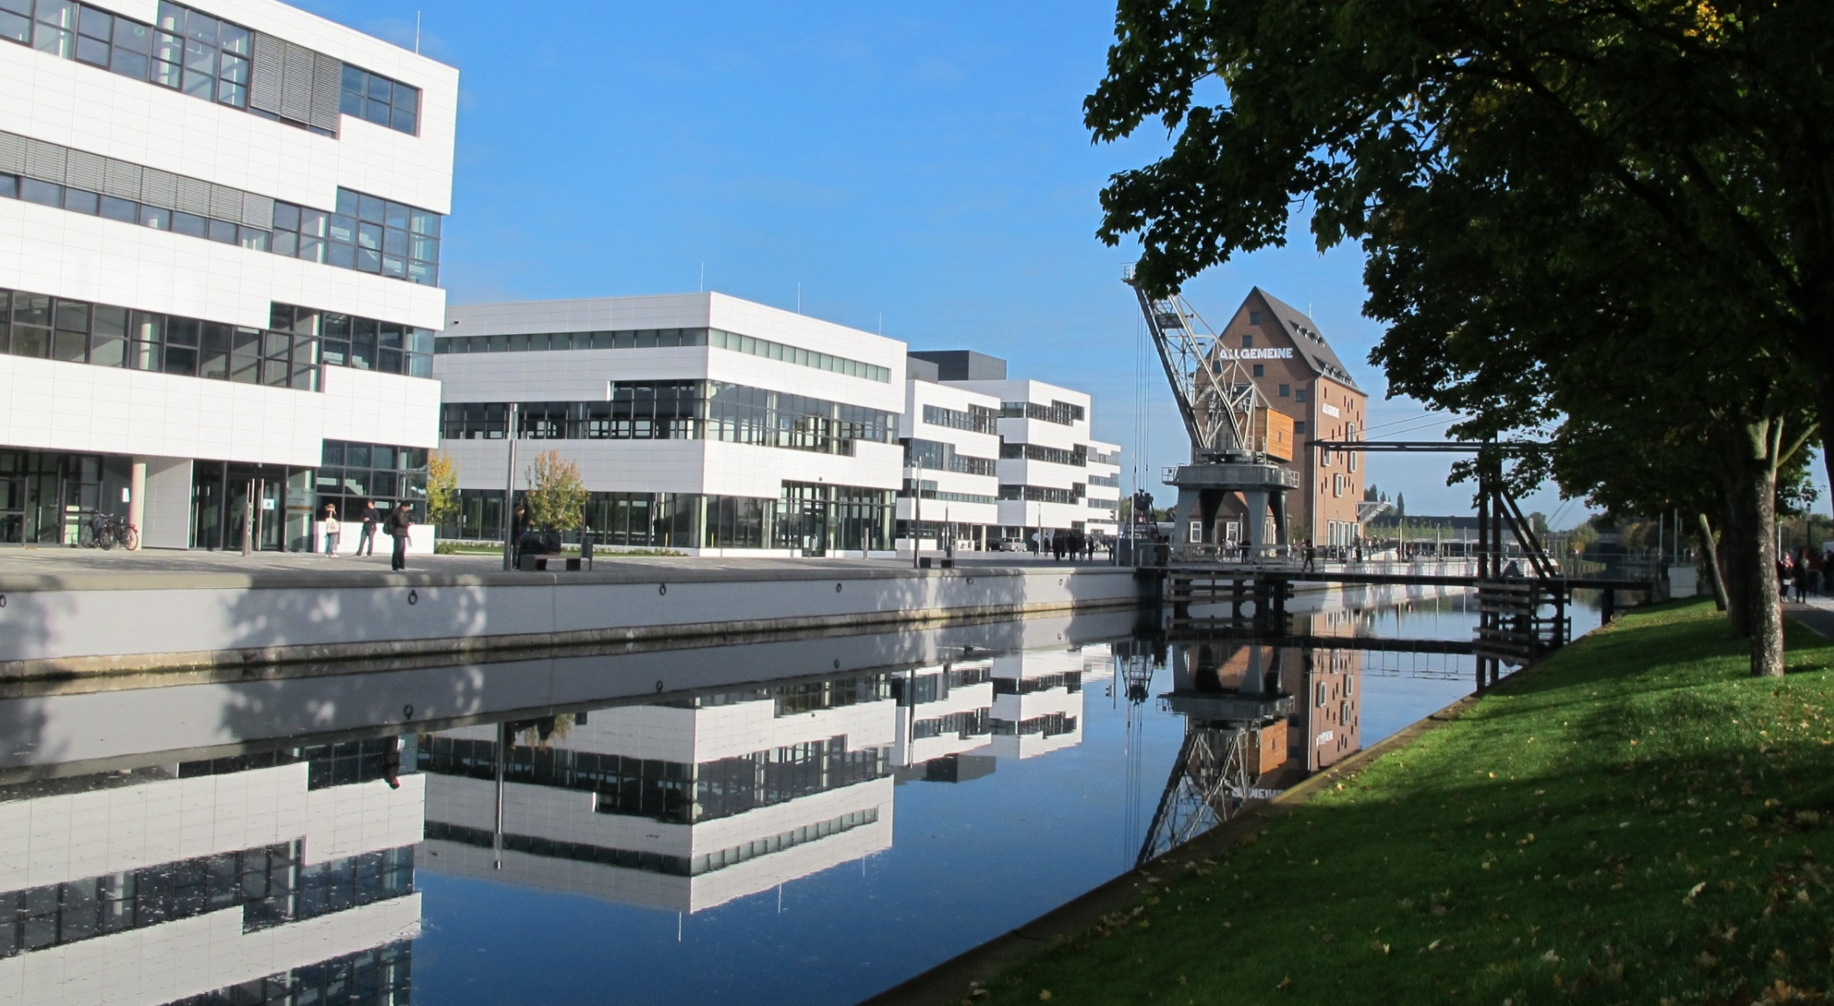
Thank you

